Slide 1
Psalm 2
Why do the nations rage?

Slide 2
Why do the nations rage[a] (Conspire)
and the peoples plot in vain?
2 The kings of the earth set themselves,
and the rulers take counsel together,
against the Lord and against his Anointed, saying,
3 “Let us burst their bonds apart
and cast away their cords from us.”

Slide 3
4 He who sits in the heavens laughs;
the Lord holds them in derision.
5 Then he will speak to them in his wrath,
and terrify them in his fury, saying,
6 “As for me, I have set my King
on Zion, my holy hill.”

Slide 4
7 I will tell of the decree:
The Lord said to me, “You are my Son;
today I have begotten you.
8 Ask of me, and I will make the nations your heritage,
and the ends of the earth your possession.
9 You shall break[b] them with a rod of iron
and dash them in pieces like a potter's vessel.”

Slide 5
10 Now therefore, O kings, be wise;
be warned, O rulers of the earth.
11 Serve the Lord with fear,
and rejoice with trembling.
12 Kiss the Son,
lest he be angry, and you perish in the way,
for his wrath is quickly kindled.
Blessed are all who take refuge in him.

Slide 6
Psalm 2
V 1-3 What the leaders and people say
V 4-6 What God thinks of this
V 7-9 God’s decree to the nations
V 10-12 God patience won’t last forever

Slide 7
Psalm 2
What was God saying when written?
What does it prophesy about Jesus?
What does this means to us?

Slide 8
What was God saying when written?

Slide 9
Acts 4 v 25 - 26
25 You spoke by the Holy Spirit through the mouth of your servant, our father David:
“‘Why do the nations rage
and the peoples plot in vain?
26 The kings of the earth rise up
and the rulers band together
against the Lord
and against his anointed one

Slide 10
2 Sam 8 v 15
15 So David reigned over all Israel. And David administered justice and equity to all his people.

Slide 11
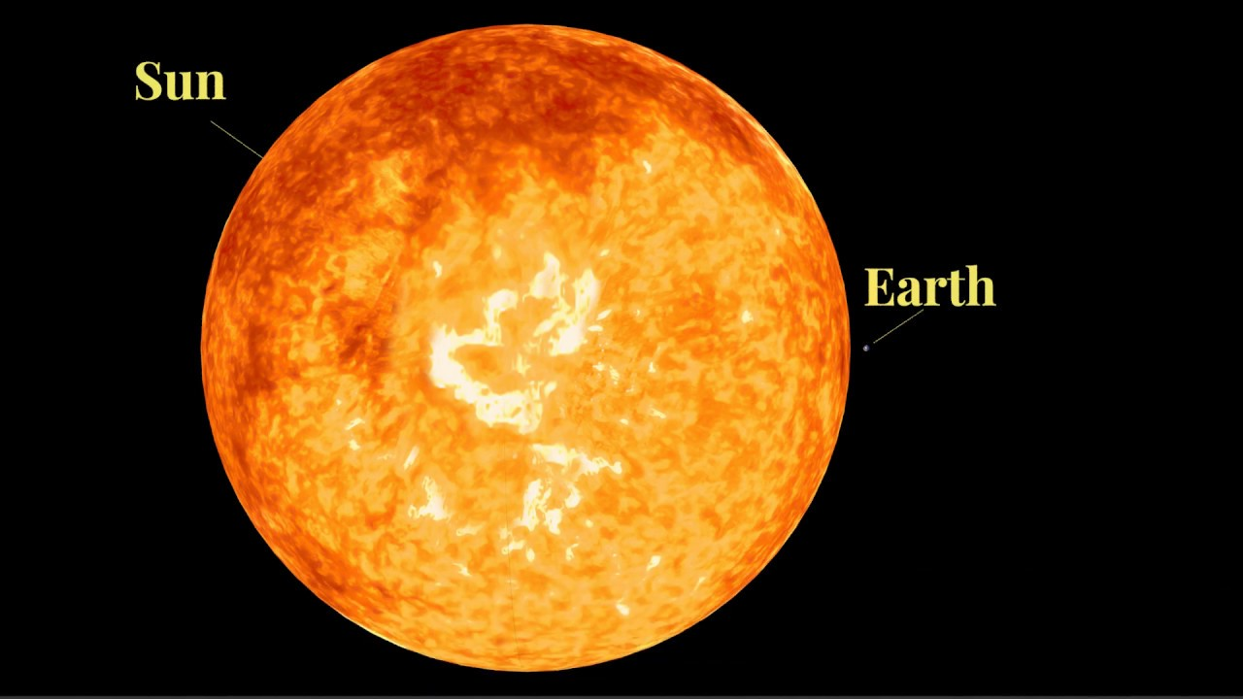

Slide 12
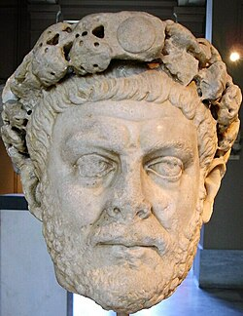

Slide 13
What does it prophesy about Jesus?

Slide 14
Luke 4 v 16 - 19
16 And he came to Nazareth, where he had been brought up. And as was his custom, he went to the synagogue on the Sabbath day, and he stood up to read. 17 And the scroll of the prophet Isaiah was given to him. He unrolled the scroll and found the place where it was written,
18 “The Spirit of the Lord is upon me,
because he has anointed me
to proclaim good news to the poor.
He has sent me to proclaim liberty to the captives
and recovering of sight to the blind,
to set at liberty those who are oppressed,
19 to proclaim the year of the Lord's favor.”

Slide 15
Revelation 11:15
Then the seventh angel sounded: And there were loud voices in heaven, saying, “The kingdoms of this world have become the kingdoms of our Lord and of His Christ, and He shall reign forever and ever!”

Slide 16
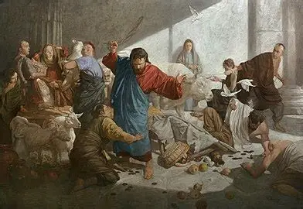

Slide 17
Matthew 21 v 12 -13
12 And Jesus entered the temple[b] and drove out all who sold and bought in the temple, and he overturned the tables of the money-changers and the seats of those who sold pigeons. 13 He said to them, “It is written, ‘My house shall be called a house of prayer,’ but you make it a den of robbers.”

Slide 18
What does this means to us?

Slide 19
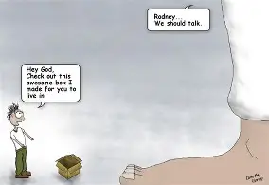

Slide 20
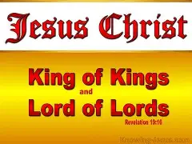

Slide 21
